Slide 1
Amerigroup Medicare Advantage Plans
Medicare Basics and our plan benefits

Slide 2
For today…
Who am I?
Why Amerigroup?
Medicare Overview
How the Plan works
Eligibility
Benefits
How do I enroll?

Slide 3
Who Am I?
Licensed Agent
Trained in Medicare and our Plans
Experienced

Slide 4
Why Amerigroup?
Trust
With nearly 69* million people served by its affiliated companies, including more than 37* million enrolled in its family of health plans, our parent company is one of the nation's leading health benefits companies.
Experience
Provider of health care benefit plans since Medicare began
Customer Service
Our call center answers calls within 17.8 seconds**
And 97.19% claims are processed within 30 days†
*antheminc.com - Corporate Fact Sheet rev 9/2015 ** average based on 5-month period starting January 2016 † Q3 2015-Q1 2016

Slide 5
Medicare Overview

Slide 6
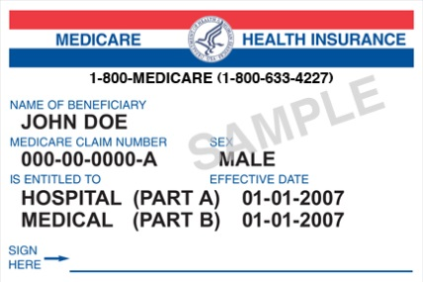
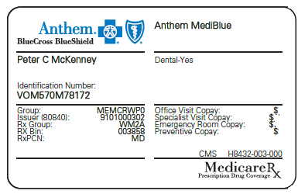
Original Medicare Vs. Medicare Advantage
Original Medicare
Medicare Advantage
OR
+
+
Part D Card
Medicare Supplement Card
(Most Medicare Advantage Plans cover prescription drugs. You may be able to add drug coverage in some plan types if not already included.)
Requires three ID Cards
Requires ONLY one ID Card
* Stand-alone Part D with Private Fee-For-Service (PFFS) or Medicare Medical Savings Account (MSA) requires separate ID cards.
Notes:
Again Simple one card does it all
No paying for Part D and Medicare Supplement
Protects your ID – the MA card does not have your SS number on it. No need to carry the Medicare card anymore

Slide 7
How the Plan Works
Covers Gaps in Original Medicare
Includes all the benefits of original Medicare and MORE
Protects you against high out-of-pocket costs
Keeps your monthly premiums low
Coordinates your care
Notes:
Keeps it simple
All in one plan
Coordinated through a medical group
Predictable copay

Slide 8
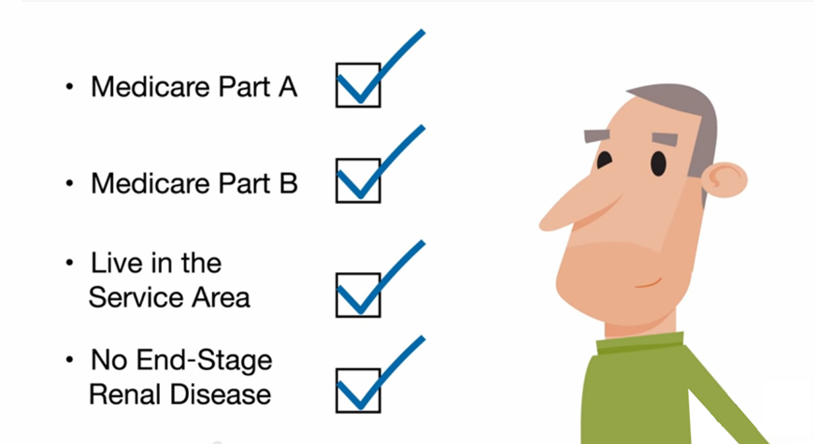
Are you eligible for a Medicare Advantage Plan?
Notes:
Run through the simplicity of enrollment and I am here to help.
This is a repeat of what you saw in the video.

Slide 9
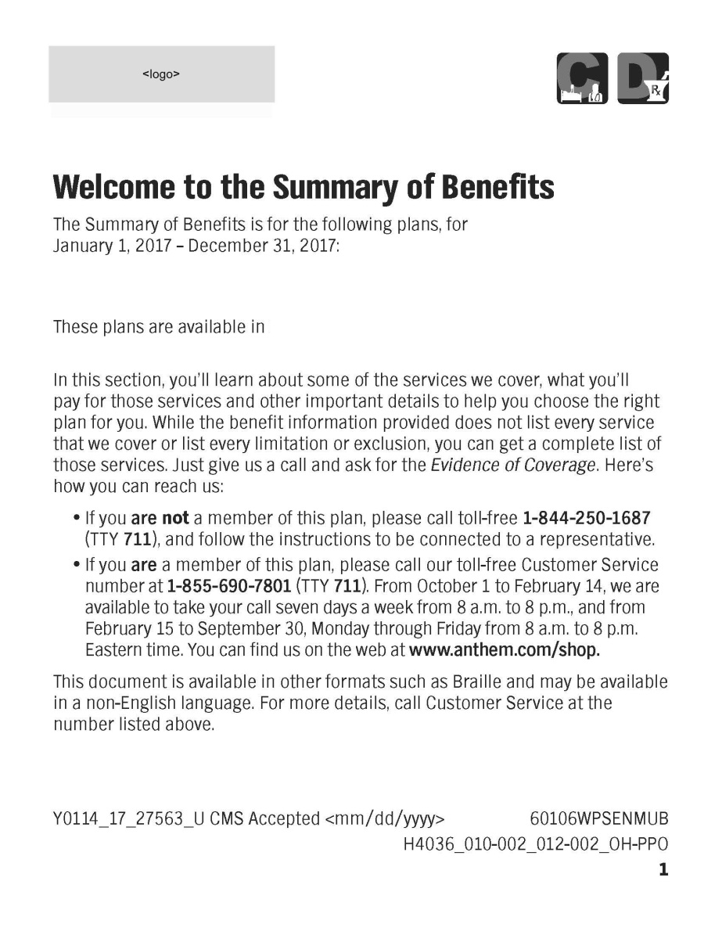
What are our benefits? Follow along…
Notes:
Open the Summary of Benefit and lets walk through it together.
Pick out the highpoints.

Slide 10
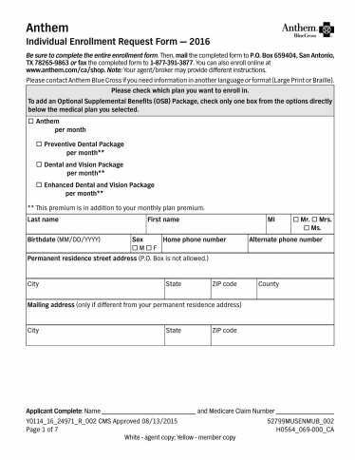
How to enroll
Select a Plan
Notes:
Let start with filling out the application.

Slide 11
How to enroll
Select a Plan
Fill out your info

Slide 12
Additional Information
Limitations, copayments, and restrictions may apply. Benefits, premiums and/or co-payments/co-insurance may change on January 1 of each year. This information is not a complete description of benefits. Contact the plan for more information. You must continue to pay your Medicare Part B premium. Part B premium is covered by the State for full dual members. For Special Needs Plans Only: This plan is available to anyone who has both Medical Assistance from the State and Medicare. Premiums, co-pays, co-insurance, and deductibles may vary based on the level of Extra Help you receive. Please contact the plan for further details. Amerigroup does not discriminate, exclude people, or treat them differently on the basis of race, color, national origin, sex, age or disability in its health programs and activities. ATTENTION: If you speak a language other than English, language assistance services, free of charge, are available to you. Call 1-877-470-4131 (TTY 711). ATENCIÓN: si habla español, tiene a su disposición servicios gratuitos de asistencia lingüística. Llame al 1-877-470-4131 (TTY 711). 注意：如果您使用繁體中文，您可以免費獲得語言援助服務。請致電 1-877-470-4131 (TTY 711). D77 baa ak0 n7n7zin: D77 saad bee y1n7[ti’go Diné Bizaad, saad bee 1k1’1n7da’1wo’d66’, t’11 jiik’eh, 47 n1 h0l=, koj8’ h0d77lnih 1-877-470-4131 (TTY 711). .(TTY 711) 1-877-470-4131 مقرب لصتا .ناجملاب كل رفاوتت ةيوغللا ةدعاسملا تامدخ نإف ،ةغللا ركذا ثدحتت تنك اذإ :ةظوحلم CHÚ Ý: Nếu bạn nói Tiếng Việt, có các dịch vụ hỗ trợ ngôn ngữ miễn phí dành cho bạn. Gọi số 1-877-470-4131 (TTY 711). Amerigroup renews its contract with Medicare (the federal government) each year on January 1. Premiums and benefits may change at that time, but not during the year, unless the change is to your advantage. In addition, the plan may reduce its service area and no longer offer services in the area where the beneficiary resides. If we do not renew our contract, we’ll tell you at least 90 days in advance. You may then switch to a standard Medigap plan (A, B, C, F, K or L) that won’t deny coverage because of a pre-existing condition. It will normally go into effect the day after your Medicare Advantage membership ends. The Formulary, pharmacy network, and/or provider network may change at any time. You will receive notice when necessary. Amounts are for one-month supply at a preferred retail pharmacy/standard retail pharmacy.
Amerigroup is a Medicare Advantage Organization with a Medicare contract. The D-SNP plans are plans with a Medicare contract and a contract with the state Medicaid program. Enrollment in Amerigroup depends on contract renewal.
Y0114_17_28139_R_001 CMS Approved 9/8/2016 61289MUSENMUB_001

